Slide 1
Investigation Automation: Progress Update
Stuart Wurtman
Raag Patel
Adrian Telan

Slide 2
Status Report: Recap &
Summary
Initial Plan: What Should be Finished
Archive Functionality Implemented for Various Sites and their Pages (Youtube videos, Twitter Posts, etc.)
Database to catalog Archived Sites
Extension Download Page
Goals Achieved:
Archive Functionality partially implemented

Slide 3
Changes: Scope Reduction
Our initial presentation was ambitious, we are now focusing on these features.
Archive metadata on any specific web page.
Archive/crawl a specific twitter post for all content connected to it
Archive/crawl a specific reddit post for all content connected to it.
Develop a user interface and backend that supports search, cataloging, and project sharing.

Slide 4
Changes: Timeline Made
For this semester, instead of continuing to implement all our scrapers, we decided to limit ourselves to testing different methods of scraping instead.
We realized we needed to better define the project architecture. We needed two pieces
A browser extension or interface
A server component.

Slide 5
Architecture
The browser extension will encapsulate most user interaction, and trigger actions that involve the server component.
The server component processes and stores data, runs the crawlers, and does other online tasks.
Server development will start local. We are currently evaluating cloud options.
We are also evaluation cross-platform browser extension development.

Slide 6
Status Report
We started testing Scrapy on some sites to test web scraping.
We learned that many sites use security measures that effectively limit how fast you can scrape web content.
We will need to
Use site APIs where possible.
Design scrapers that focus on specific content to reduce web requests.

Slide 7
Status Report: Challenges
Major Problems Encountered:
Incapsula problems with some desired sites
Too many requests when crawling
Went down a bad path
Tried to have a web extension run shell commands locally
Too much deliberation
Switch to JS web crawling, or stick to Python?

Slide 8
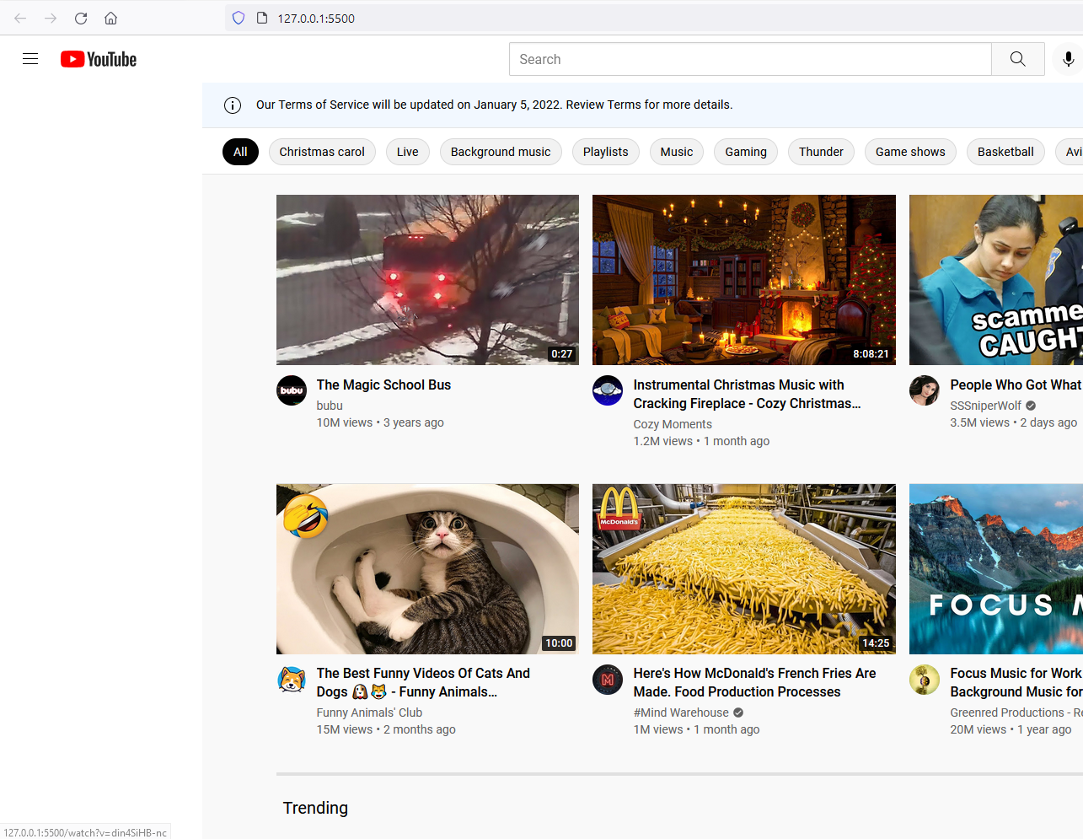
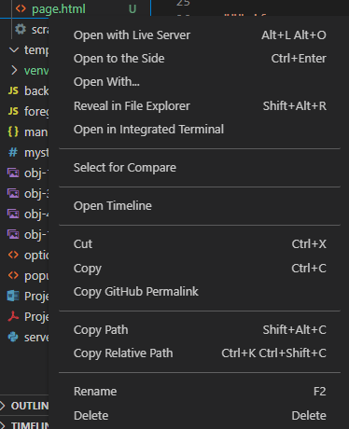
Status Report: Archive
Function
Terminal Command
HTML file saved locally

Slide 9
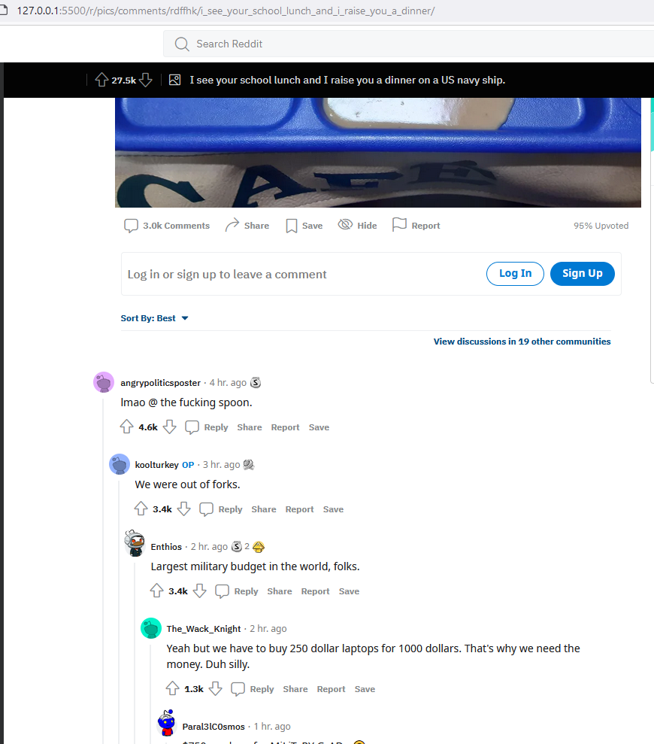
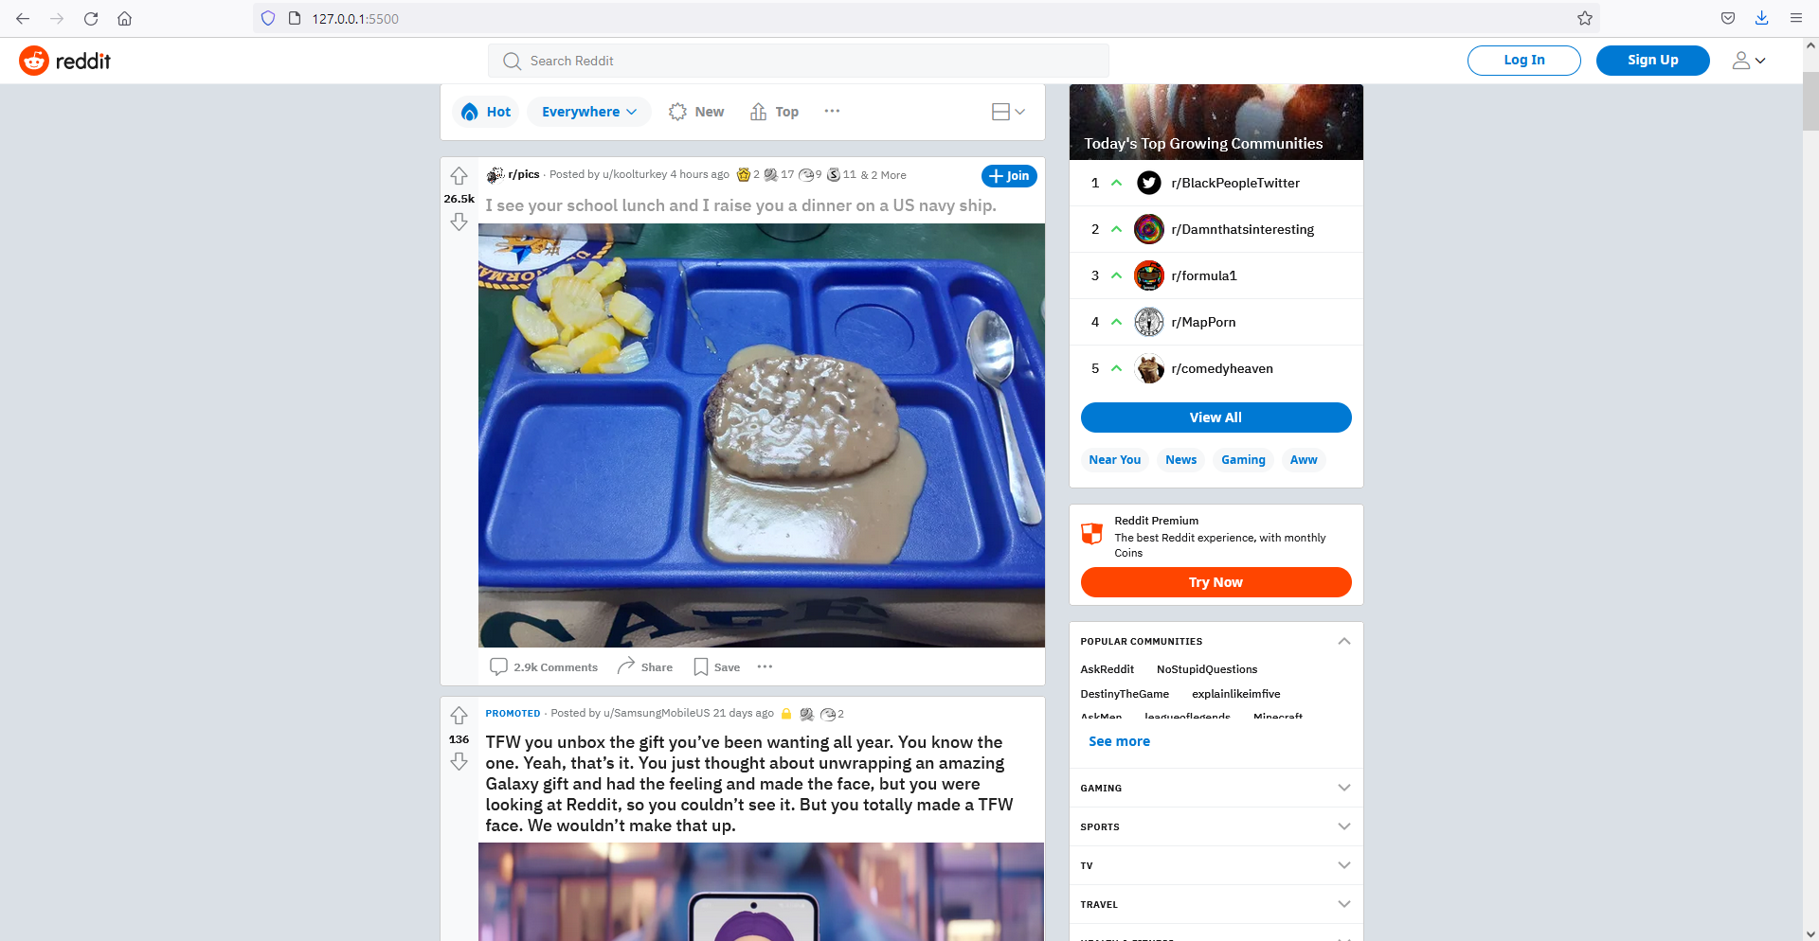
Status Report: Archive
Function

Slide 10
Status Report: Archive
Function

